Slide 1

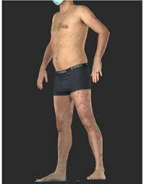
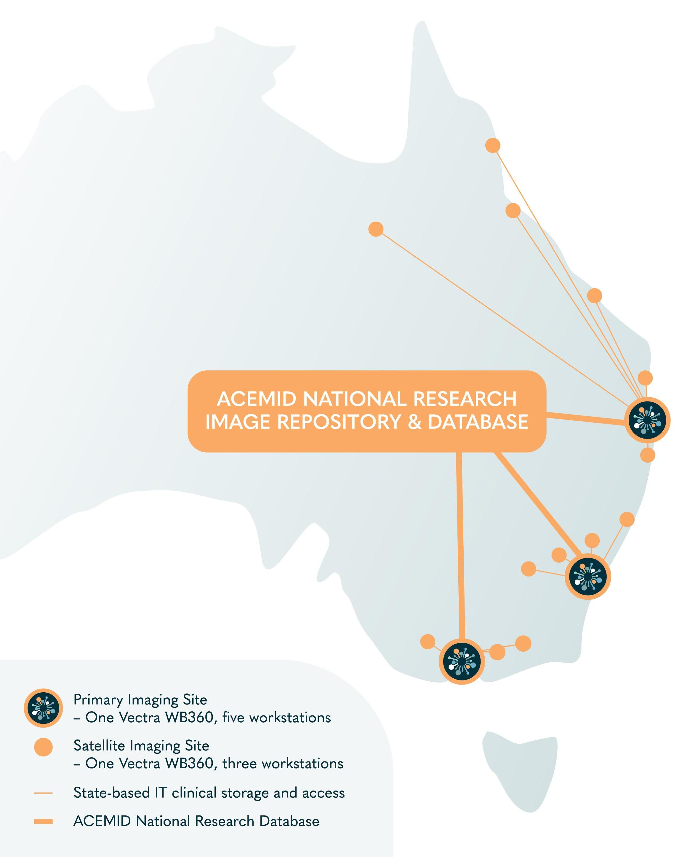
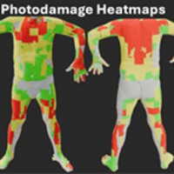
Image related data extraction workflow
Naevus data
Naevus counts
Naevus size
Assigned: Adam
Data: 3D images
Script 1
Script 3
Spatial distribution
data
Sensitive data – handled by sites individually
Assigned: Dilki, Adam
Data: Lesion tiles and x,y,z coordinates
from JSON files
Deidentified less sensitive data – Available for data analysis
All lesion data saved in JSON files extracted and saved in RDMs
Script 4
Skin
colour
data
Assigned: Adam, Dilki, Chantal
Data: Image tiles from JSON files
Photodamage data
Score per body site
Script 2
Assigned: Adam
Zongyuan’s team
Data: Raw 2D images
Photodamage data in csv files
extracted using the AI and saved in RDMs

Slide 2

RedCap data extraction workflow
Demographics
Assigned: Nayomi, State Managers, MASK
Data: Questionnaire
Socioeconomic & Lifestyle
All baseline characteristics saved as csv files extracted and saved in RDMs
Script 5/ Instructions
Sensitive data – handled by sites individually
Deidentified less sensitive data – Available for data analysis
Medical &
Skin Cancer History
Phenotypic factors
QoL/Anxiety/
Acceptability & Trust
Melanoma
Script 6/ Instructions
Events in cohort
Saved as csv files
and saved in RDMs
Assigned: Nayomi, State Managers, MASK
Data: Entered data from pathology reports
KCs
Benign lesions

Slide 3
Analysis plan
Deep image phenotyping
Unsupervised clustering of phenotypes
Naevus data
Naevus counts
Naevus size
Demographics
Socioeconomic & Lifestyle
Spatial distribution
data
Melanoma
Cancer outcomes, anatomical distribution and diagnostic efficiency
KCs
Table 1
Phenotypic factors
Photodamage data
Benign lesions
Medical &
Skin Cancer History
Skin
colour
data
QoL/Anxiety/
Acceptability & Trust

